Slide 1

Advertisement CTR Prediction
Present Solution
DS5220 / Fall 2023 Semester
Team Members: Liyang Song, Qian Yin
Dec 10, 2023

Slide 2
Background – big picture
Initially, the goal is to increase the efficiency of targeted advertising by accurately predicting the likelihood of a user clicking on an advertisement, enabling improved return on investment (ROI) and lower cost on advertising. Therefore, we want to find the best model for the CTR (Click-Through Rate) prediction.
There are many performance metrices to evaluate the model. In our project, we decide to focus on minimizing false positives while balancing with other metrics.
We mainly consider precision or false positive rather than false negative because the project target is recommending advertisements to users based on the click rate prediction. As a result, higher false positive would show more advertisements that the user would be less likely to click. And this could make the user feel less engaged and tend the leave the applicaton.

Slide 3
What we have done – the ML workflow
Phase II
Phase III
Read in data
Check duplicate obs
Check nans target obs
Identify attributes types
Phase IV
Train/Validation split
Train/Test split
Check correlation
Check out missingness
Drop duplicate obs
Drop nans target obs
Drop missingness
Drop high correlation
Phase V
Check permutation importance
Evaluate default model on validation set
Evaluate default model on train set
Identify drop attr list

Slide 4
What we have done – the ML workflow (continued)
Phase VI
Feature selection
Shortlist compromising models
Tune hyperparameters using Grid Search
Evaluate tuned models on validation
Compare best models’ performance
Get the best models
Evaluate tuned threshold
Tune threshold on tuned models
Select the final model for testing
Evaluate the final model on test set

Slide 5
Our solution – the final best model
After tuning the model hyperparameters and threshold for each best model. We evaluated them on bootstrapped validation set.
Gradient Boosting Classifier has very high Precision (which is what we demands firstly) and a very high recall. It would be the ideal model for production.

Slide 6
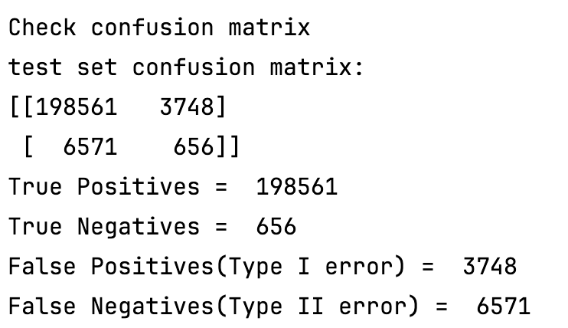
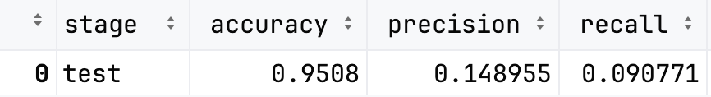
Our solution – the final best model

Slide 7
What worked and limitations
Worked
We successfully evaluate 5 different models from various categories. They perform differently on the data set and have different error tendencies.
We split the raw data into train, validation, and test sets. We use the validation set to tune hyperparameters and thresholds, and use test set only at the final step to see the performance. This makes sure there is no data leakage.
We try to automatic almost all workflows, and most model configurations are listed at the beginning cells of notebooks. Configuring them can be very easy and straightforward.
Limitations
The data set is too huge and can be hard to train and fit on our personal laptops. We have to resample a small part of the raw data set such that our work can be done.
The raw data is highly imbalanced, and we decided to oversample it at the final stage. Which makes the whole workflow has to be run and evaluated again. This makes our time very limited.

